Slide 1

College Starter
Team member:
Anitha Patteda
Dhruvit Patel
Rohini Rao
Vandna Yadav
Prof. Greg Vesonder

Slide 2
Description of Project
A mobile application focused on providing a variety of information about the university ,primarily to newly admitted students.
The app serves as a mobile directory to help students easily find campus hot-spots and convenient ways to navigate the campus and also places near-by.

Slide 3
Primary “E” - Engaging
Target Population
Engaging - Which attracts the new students and visitors and it also easy to use for novice users.
All students and faculty and also visitors on campus, but primarily newly admitted international students to the university.

Slide 4
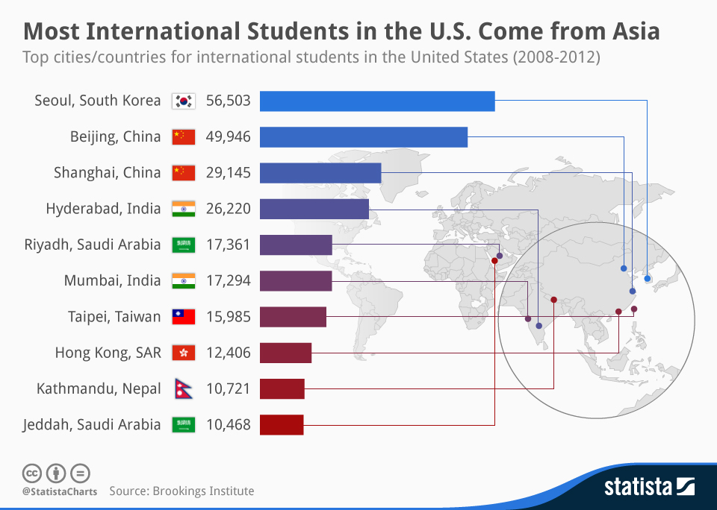
Industry Data
With regards to the top cities/countries for international students in the United States, Seoul is immovably on top. The South Korean capital contributed an amazing 56,503 student somewhere around 2008 and 2012. Beijing comes next with 49,946 while another Chinese city, Shanghai, rounds off the top three with 29,145.

Slide 5
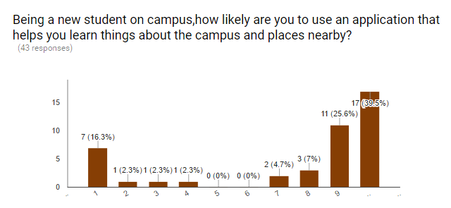
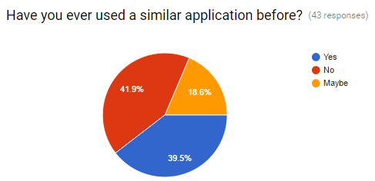
User survey results
Data used for Persona: An Online survey made using Google forms.
Persona trait: A majority of people would use a mobile application to navigate around campus and also to learn more about activities and services in and around campus.
Of all the people who took the survey, a majority 41.9% people responded by saying that they had never encountered or used a similar application before and that it was not easy get around the campus their first day on campus.

Slide 6
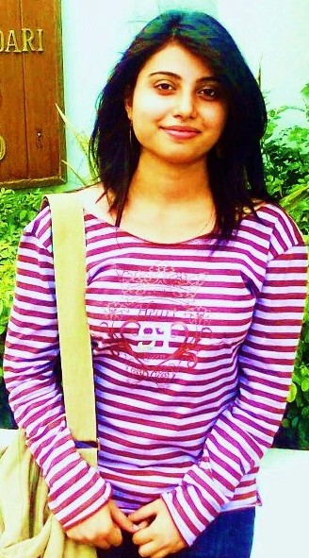
Persona
Vandna Yadav, 25
Graduate Student
Slogan: “I want to learn about campus activities quickly but I’m too modest to ask people”
A full time student pursuing Master’s Degree in Computer science and works part time for the Teleservices office at Stevens Institute of Technology.
She’s busy with school and office work load.
She wants to submit her student health form at Jacobus Hall to complete her enrollment but she doesn’t know where Jacobs Hall is.Also she needs to get her enrollment forms to the Dean’s office in time to get enrolled for classes.
She gets to know about this new app making the buzz on campus called ‘CampusStarter’ famous with the newly admitted students ;Could help her find Jacobs Hall and also Edwin Hall easily with the routing feature from current location. College Starter even shows the map so that anyone can easily route themselves to the desired destination.

Slide 7
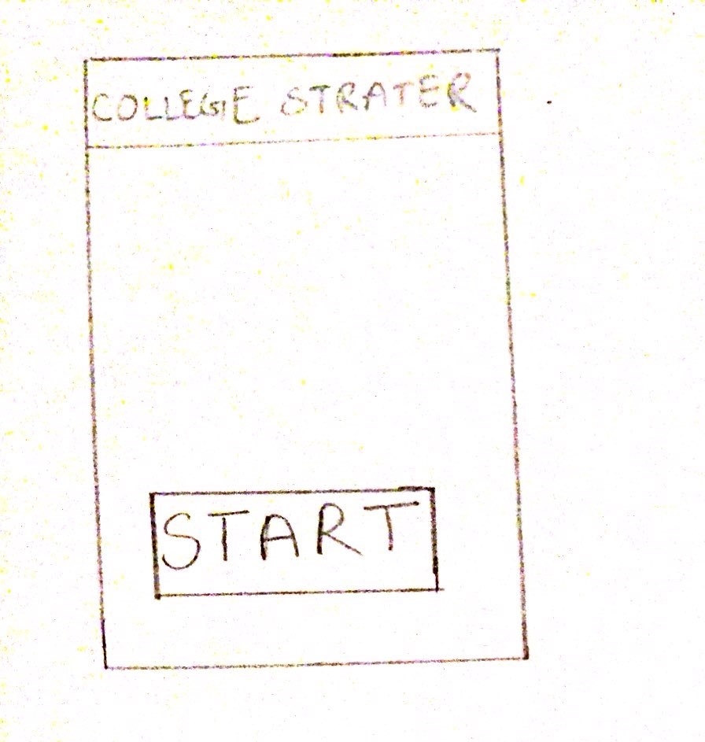
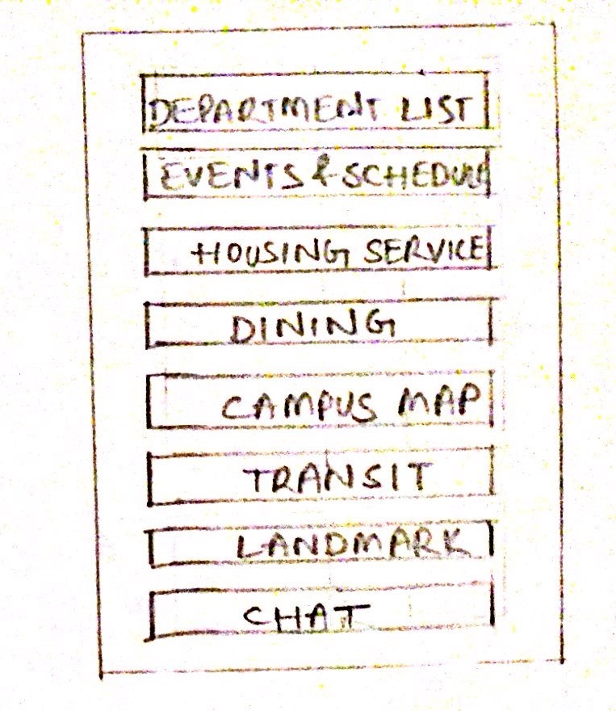
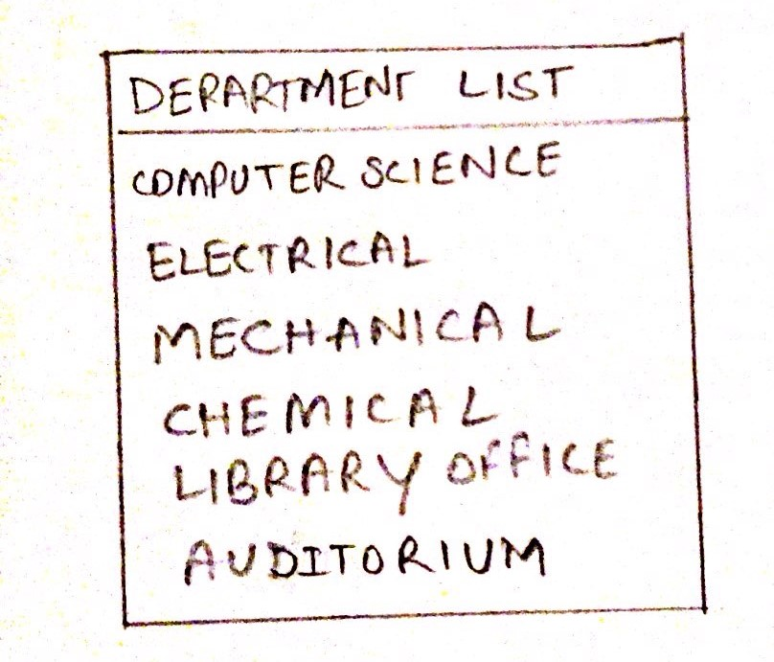
First Design - Paper Prototype

Slide 8
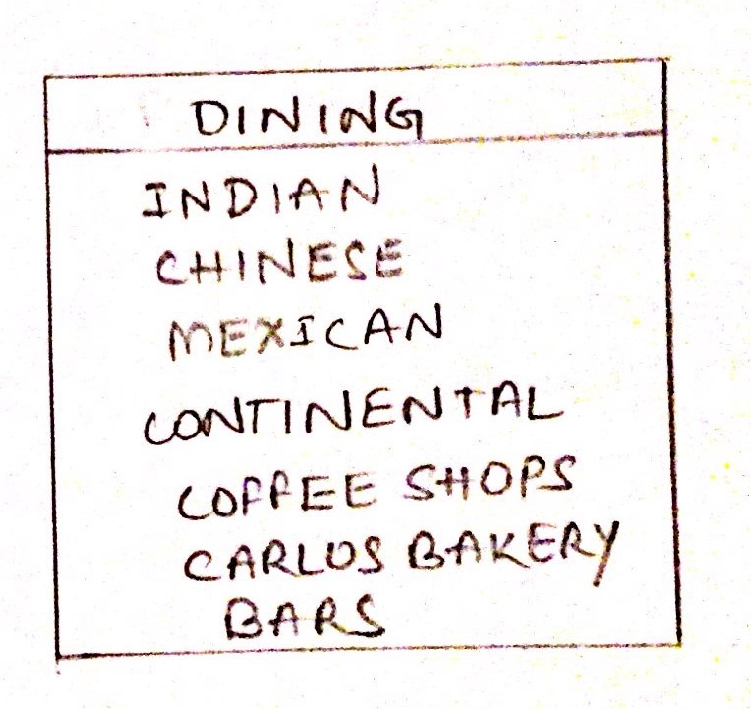
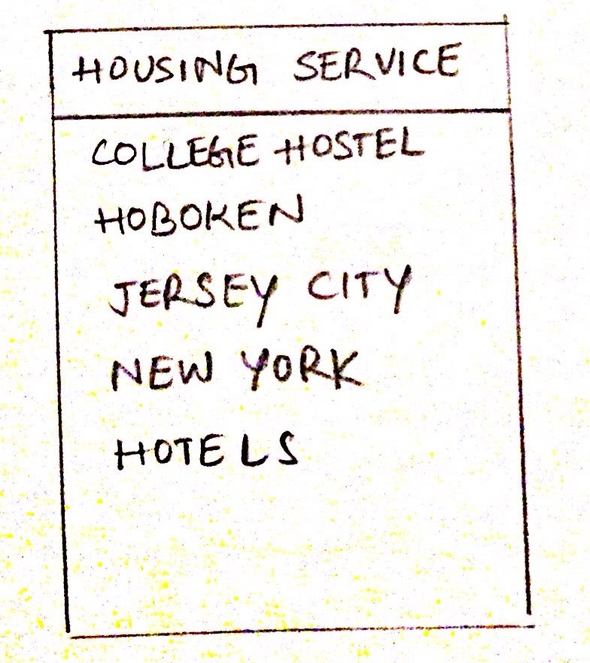
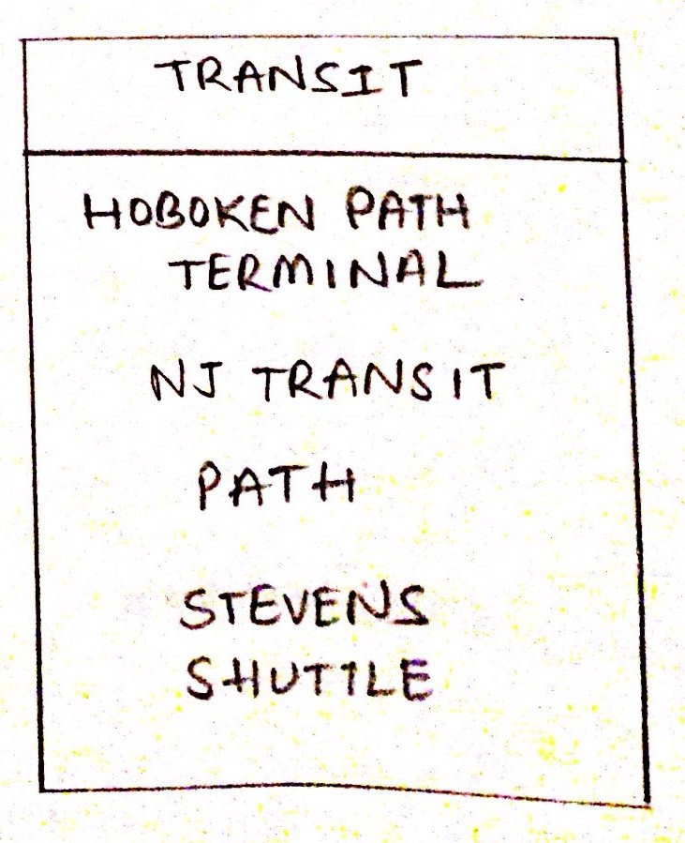
Contd...

Slide 9
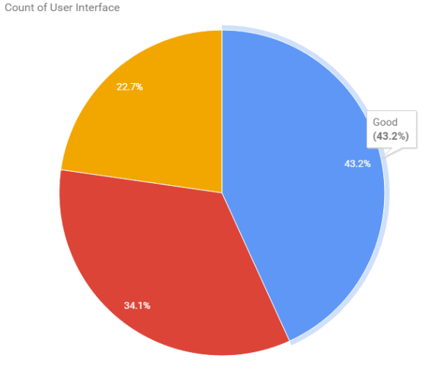
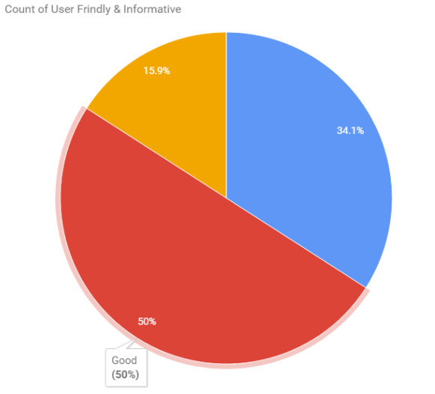
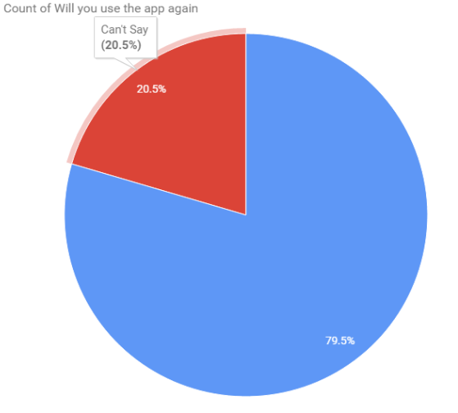
Initial Design User Feedback
We user tested with 5 users initially and 43.2% gave a go ahead for the user interface.
Design too simple.
No enough selections
No selection flow.
Based on the idea, 79.5% were supportive of the idea and said they would use the application again.

Slide 10
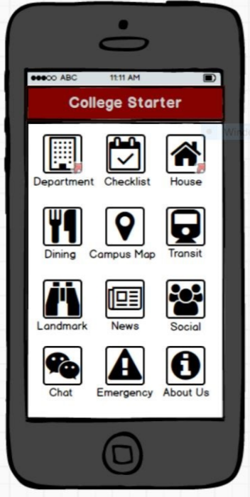
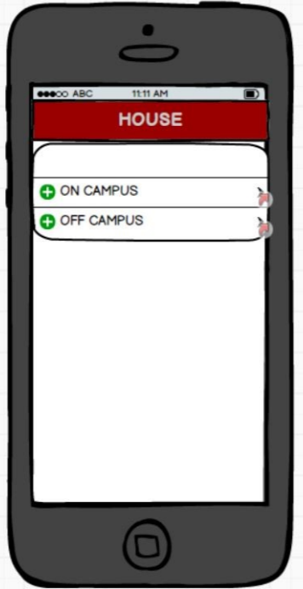
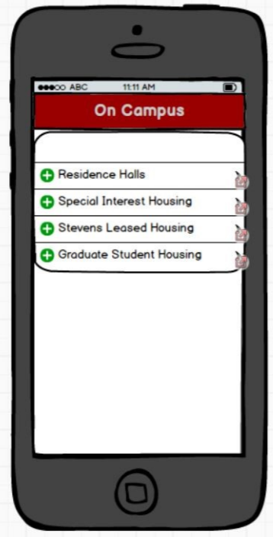
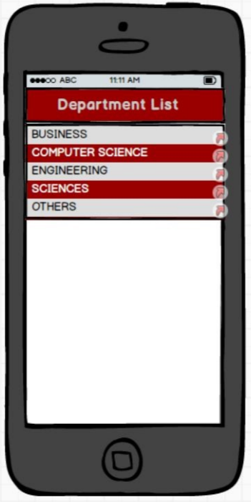
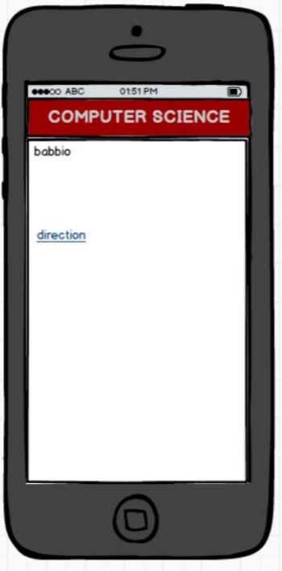
Second Design - Moqups

Slide 11
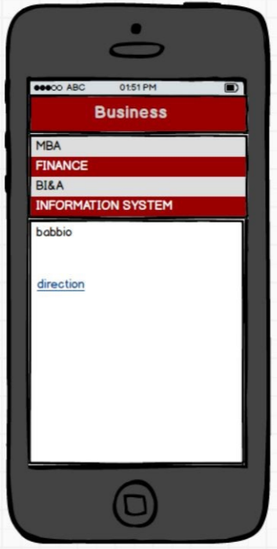
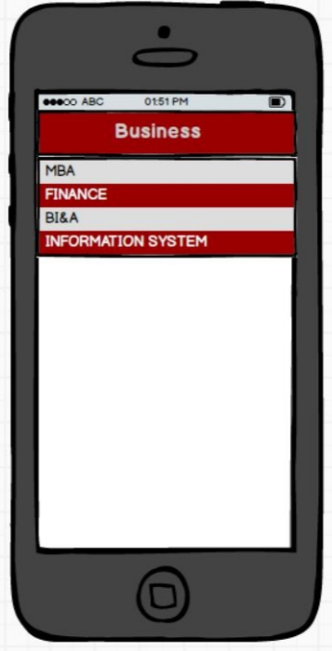
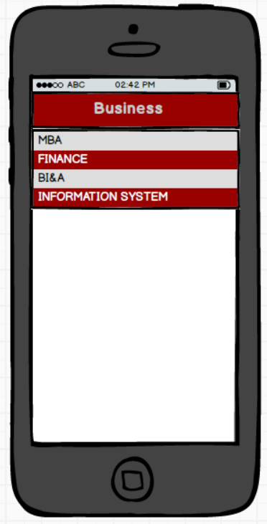
Contd..
Beginning outline was not easy to use. Additional touch info was required from the users. General feel and look of the application was not alluring.

Slide 12
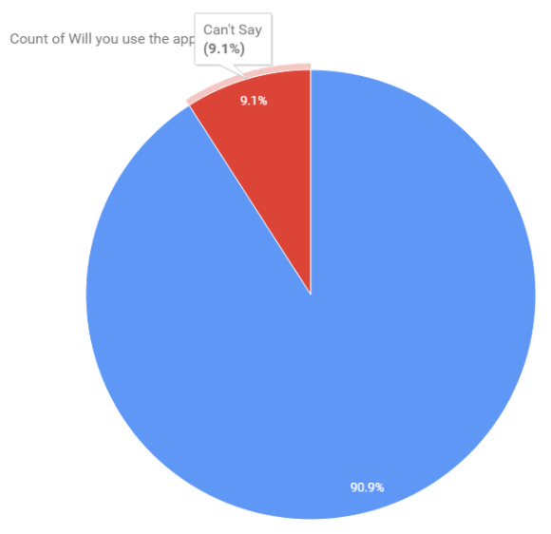
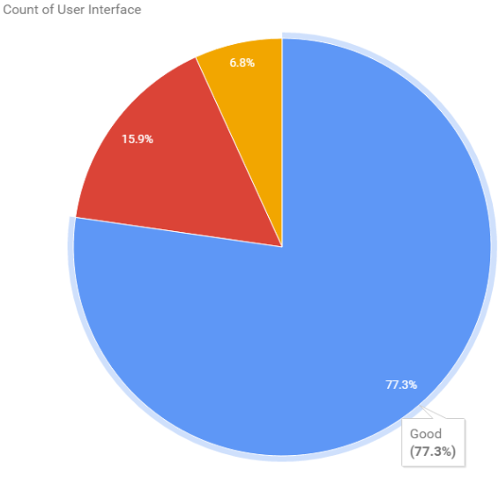
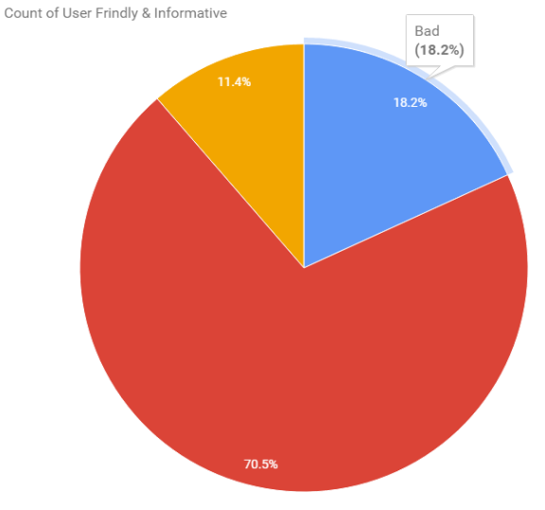
Second Design User Feedback
Application looks deficient due to content not introduced legitimately .
Users were not inspired with the user interface as it did not have the 'attention grabbing' variable.
Relatively few said that they would utilize the application once more.

Slide 13
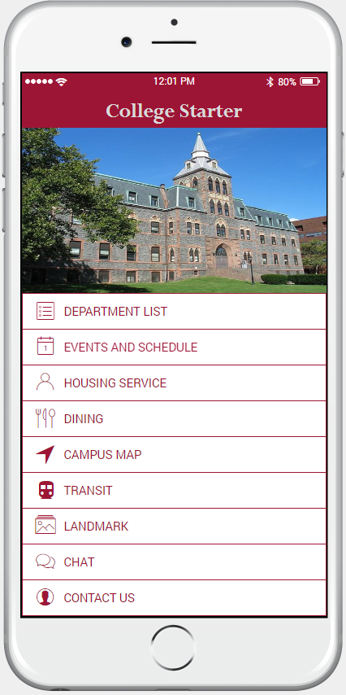
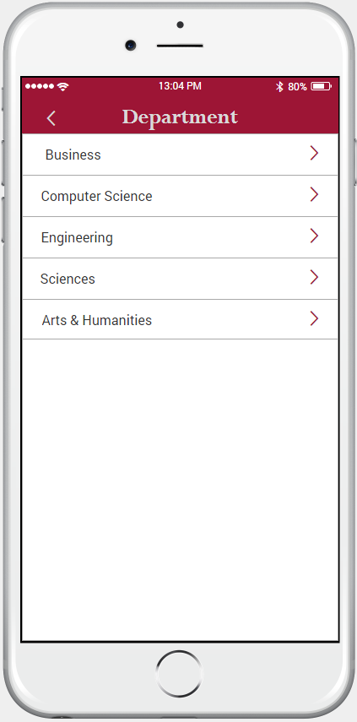
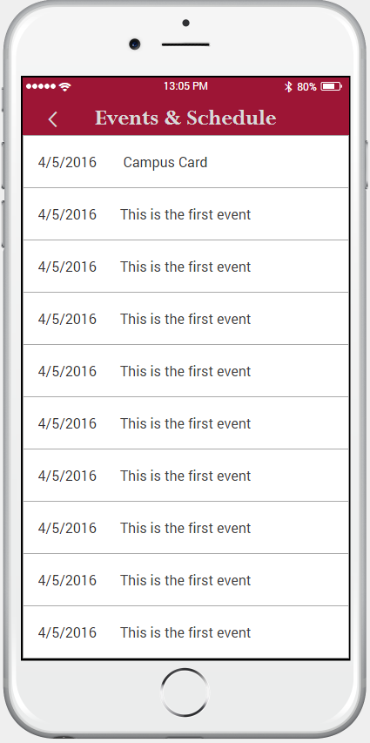
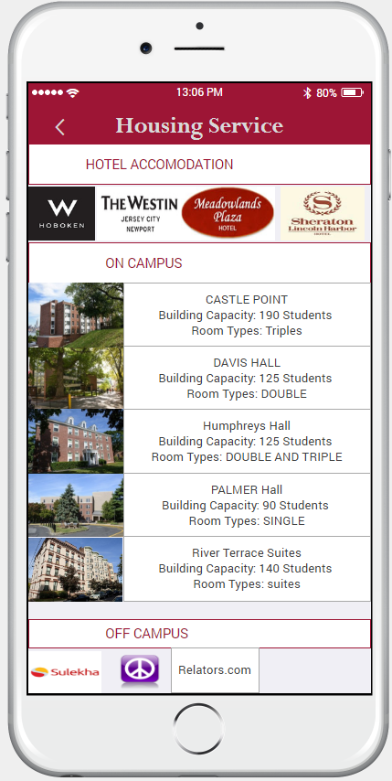
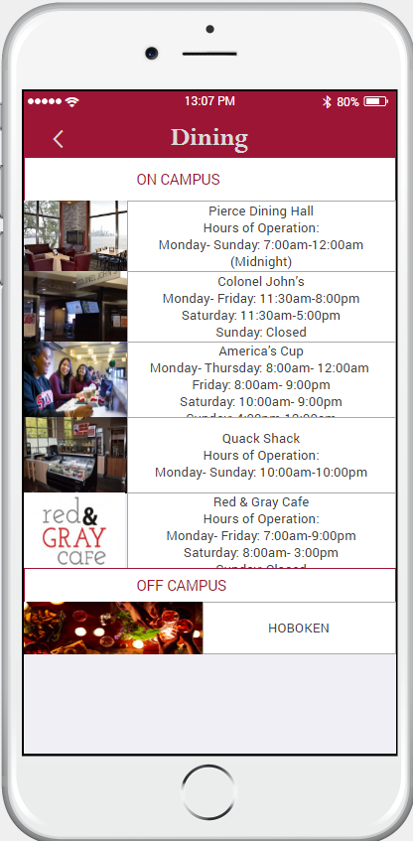
Final Design - Using JustInMind
Home page
List of Dept
Events & sch
Housing
Dining

Slide 14
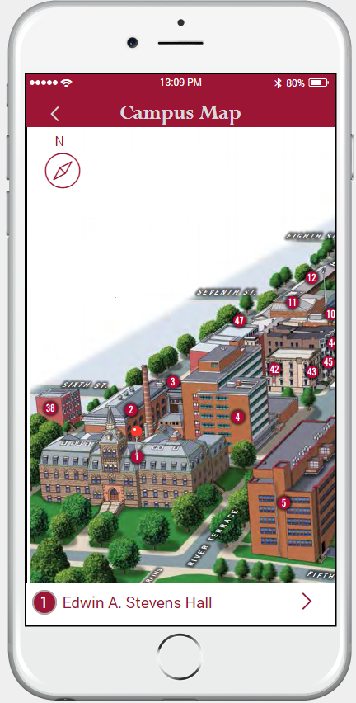
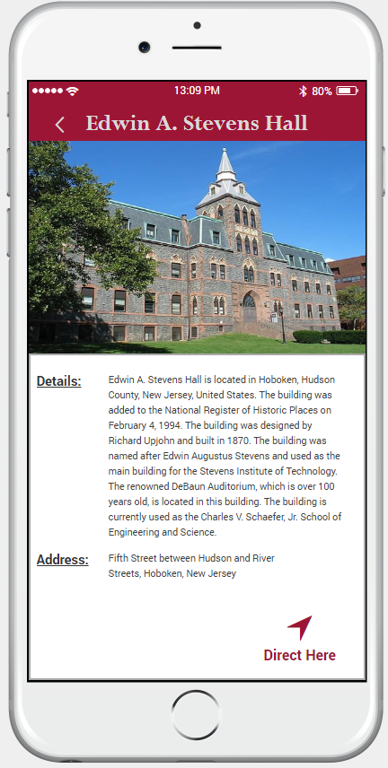
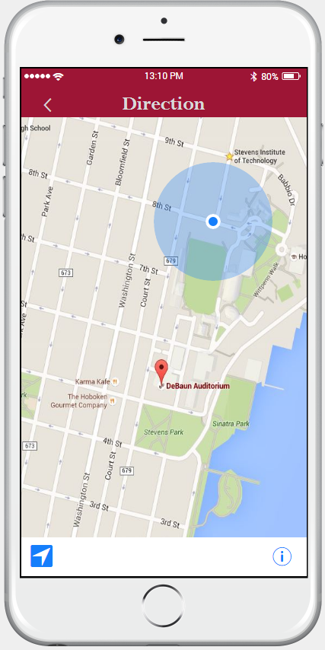
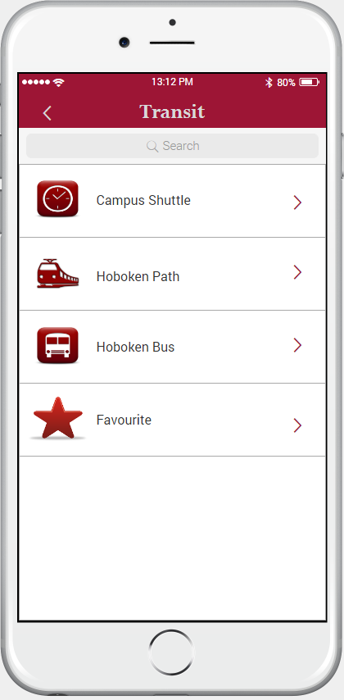
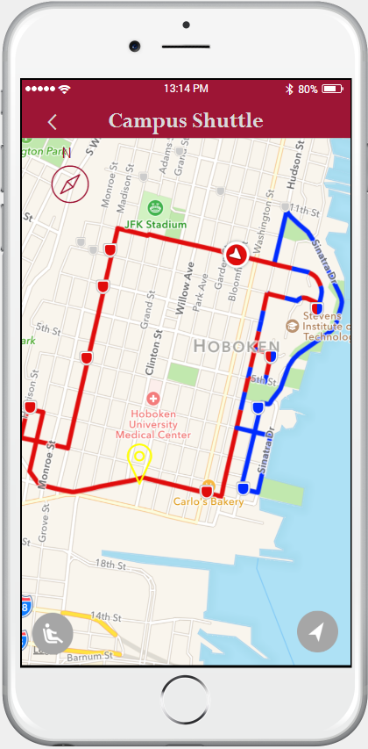
Contd...
Map
Selected location on map
Direction to selected location
Transit
details
Campus
shuttle

Slide 15
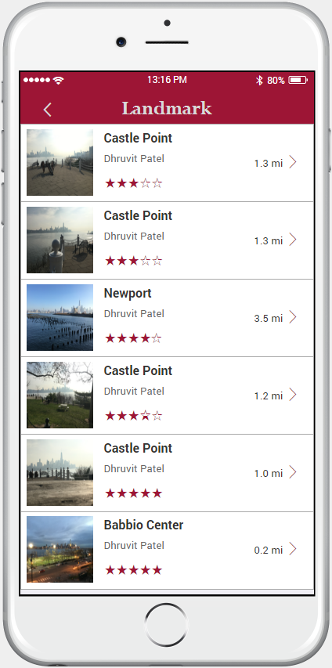
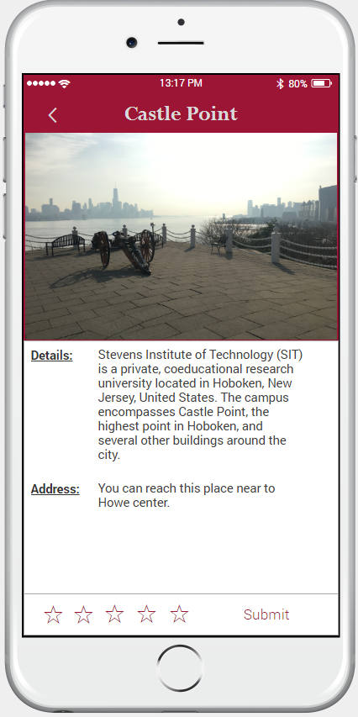
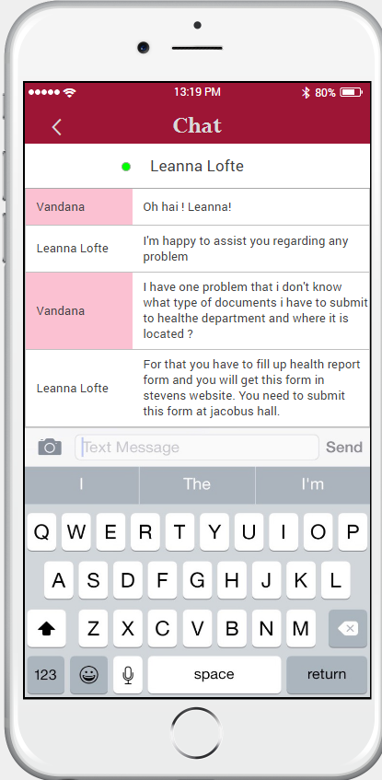
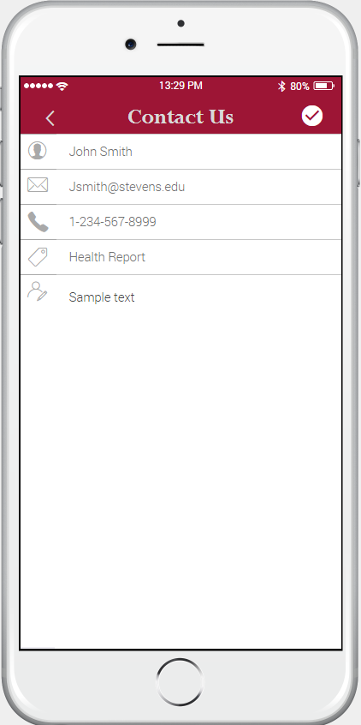
Contd...
Landmark
Selected landmark details
Chat
Contact us

Slide 16
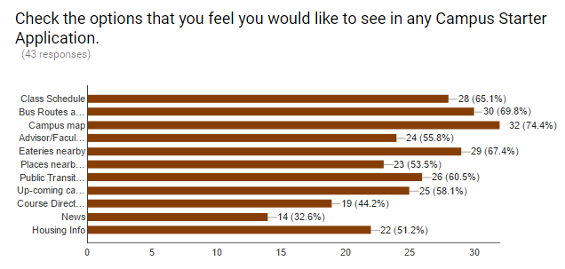
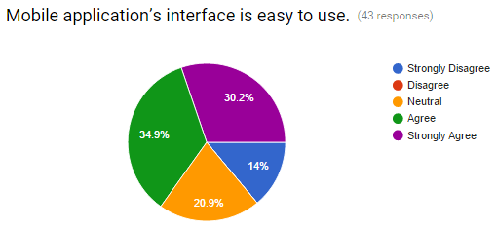
Final Design User Feedback
The features we included were also voted most popular.
Quick and user friendly interface.

Slide 17
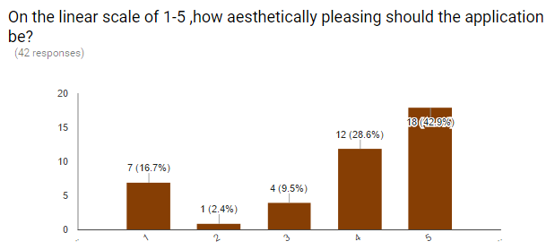
Final Design User Feedback
Most of the users agreed that the user interface could be more aesthetically pleasing.
Include information about faculty office hours along with contact information and building room numbers.
Would like to see a working application ready for use.
Link to the user feedback survey - http://goo.gl/forms/gm3bTjWGT6

Slide 18
Demo/Walkthrough Final Design
Simple to pick choices
Alluring Content
Exuberant User Interface Design
Data rich and Precise Content
Demo : https://drive.google.com/open?id=0BzHyZlxLpkk8Q0R4SDlJUzA5WXM
Download it on local machine and test user interface
Video survey:
https://www.youtube.com/watch?v=sRNy_2h_LEY

Slide 19
Review of Design
Perception -
Application is aimed at the new students , so we have tried to limit the number of pages in the app so as to keep the user interested and engaged all time. In addition we provided all the basic details like (dept, housing, dining, shuttle) to make student comfortable with new environment.
Attention -
Application design is easy to use and simple hence gains the attention of the user, we have made use of images that are appealing to the users. We provided the details which are very important to new student hence increasing the attention of the user.It is one of kind application which is not available hence gains attention.
Retention -
Application is very easy to use and the interfaces are very clear and simple so not much time is required to get accustomed to the app. Information depicting images with precise content makes it easy to navigate within the app.User will keep coming back because it helps them to adjust new environment by providing all the basic details that are required to navigate around the campus.

Slide 20
Simplicity ”subtracting the obvious and adding the meaningful”
We followed 3 laws of simplicity
Reduce - The simplest way to achieve simplicity is through thoughtful reduction.No one wants to read the website, everyone wants simple and use right away.Our application get rid of the information that is not useful to the new students, groups many Related features into single page (housing -> hotels, on campus, off campus). Hides the details Under single click. This app also covers details regarding the surroundings of the campus and nearby places.
Organise - Organization makes a system of many appear fewer.When we can’t reduce and hide then organize what’s left into something meaningful. Hence we organized the details into simple list which user can access. We prioritize the things according to
User requirements.
3. Time - Time is essence and Time is money and for students it is doubly important,The
faster you accomplish what you are set to do, the more time you have to do multiple
things. Application saves time of user by providing all the details like - transit,
dining, landmarks.User does not have google to get information, they can get all the
information using the app.

Slide 21
Accessibility Review
Use of the design is easy to understand, pages are clear and easy to find – no need for user’s experience or Knowledge.
The design minimizes hazards and the adverse consequence of unintended action. In any page of the app you can go back to home page.
Color scheme that is easy on the eyes and suits readability.
Single page provides all the details, just click on images gives more details by connecting to related website.

Slide 22
Heuristic Evaluation
1. Complexity of the application
Application is very simple and easy to use, application match the user’s real world and language, and reflect the user’s primary goals for using the app.
2. Task navigation and user controls
Application allow users to complete tasks and goals without hindrance ,Navigation is very easy and does not need any training to navigate and to use the controls
3. Consistency and standards
App consistent in naming and grammatical style for menu options, both within each menu and across the application
4. Recognition rather than memory overload
Instructions and control are clear user does not have memorize anything.The application make options Visible to the user
5. Efficient to use
Application is very simple and easy to use hence making it less error prone and efficient
6. Simplicity and appeal

Slide 23
Did you improve targeted for specific population?
This app was intended for new students but it can be used by the others too. By parents who would like to explore campus and its surroundings or by students who would like more information about buildings and faculty without the trouble of asking people.

Slide 24
Future work
Improve app to personalize campus apps for different audiences and locations–prospective students, alumni, or campuses.
Harness the power of push notifications to increase student engagement and improve campus communication.
As per the user testing feedback most of the users asked us to include the classroom details which will be implemented in the further iterations.
Planning use the ionic framework(idea we got from STEVENS INNOVATION EXPO) to implement the application which is portable across all the operating systems.
And make app accessible in their native language ( Feed from user testing)

Slide 25
Thank You

